Slide 1
Operating Systems
Chapter 6d
Process Synchronization
Hammad Afzal
hammad.afzal@mcs.edu.pk
Department of Computer Software Engineering
National University of Sciences and Technology

Slide 2
Process Synchronization
Atomic Transactions

Slide 3
System Model
Assures that operations happen as a single logical unit of work, in its entirety, or not at all (atomic)
Related to field of database systems (also applicable and useful for operating system)
Challenge is assuring atomicity despite computer system failures

Slide 4
System Model
Transaction - collection of instructions or operations that performs single logical function
Concurrent Transactions
Must be equivalent to serial execution – serializability
Could perform all transactions in critical section
Inefficient, too restrictive
Concurrency-control algorithms provide serializability

Slide 5
Serializability
Consider two data items A and B
Consider Transactions T₀ and T₁
Execute T₀, T₁ atomically
Execution sequence called schedule
Atomically executed transaction order called serial schedule
For N transactions, there are N! valid serial schedules

Slide 6
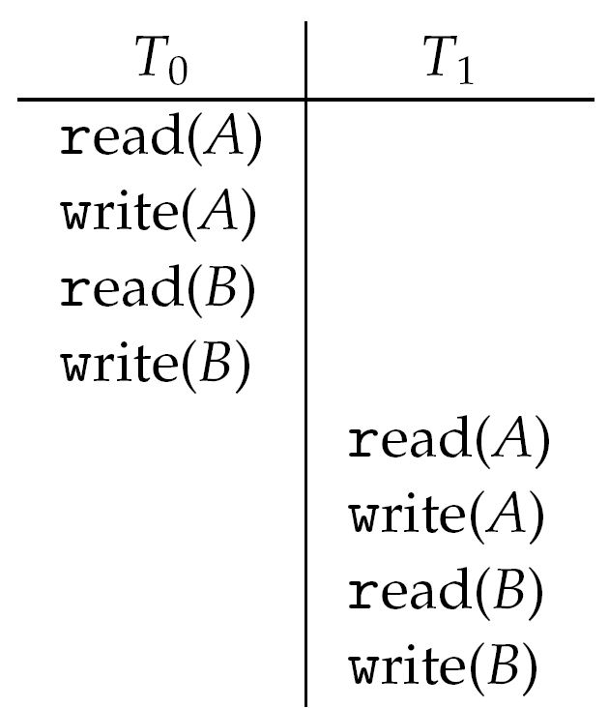
Schedule 1: T0 then T1

Slide 7
Nonserial Schedule
Non-serial schedule allows overlapped execute
Resulting execution not necessarily incorrect
Consider schedule S, operations O_{i}, O_{j}
Conflicting Operation if access same data item, with at least one write
If O_{i}, O_{j} consecutive and operations of different transactions & O_{i} and O_{j} don’t conflict
Then S’ with swapped order O_{j} O_{i} equivalent to S
If S can become S’ via swapping non-conflicting operations
S is conflict serializable

Slide 8
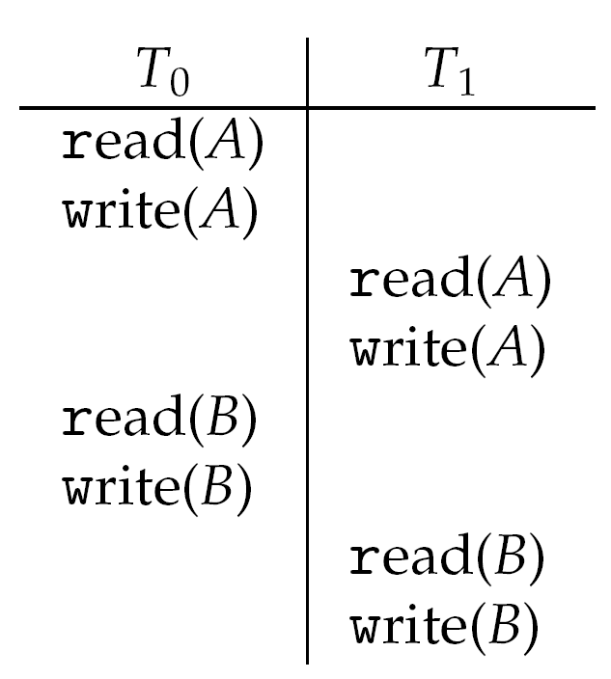
Schedule 2: Concurrent Serializable Schedule

Slide 9
Schedule 1: T0 then T1
Read a
Write a
 | Read a
 | Write a
Read b
Write b
 | Read b
 | Write b

Slide 10
End of Chapter 6

